Slide 1
Generators
Success Criteria
I can determine the direction of eddy currents.
I can calculate emf generated from an AC generator.
I can relate change in magnetic flux to voltage in an AC generator.
Notes:
Eddy currents
Solenoid induced currents
Generators
Induced current due to Earth’s magnetic field

Slide 2
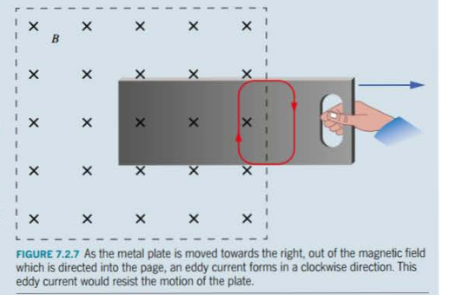
Eddy currents
Content Development
A circular electric current induced by a conductor in a changing magnetic field.
Acts to oppose the motion that causes the change in magnetic flux. Useful for regenerative
braking and induction stovetops. A major energy loss in AC generators.
If the motion causes an increase in flux into the page, the eddy current works in the
direction to cause an increase in flux out of the page.
Steps:
Work out how the flux is changing
The opposing flux must be opposite this
Use right-hand rule to determine direction of current

Slide 3
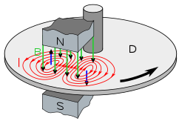
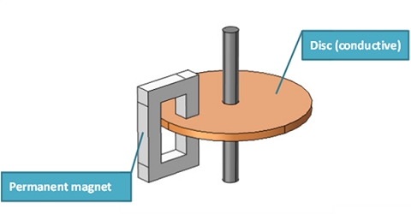
Eddy currents
Content Development
Steps:
Work out how the flux is changing
The opposing flux must be opposite this
Use right-hand rule to determine direction of current
N
S

Slide 4
Magnetic field lines
Content Development
For magnetic field lines of a wire, make sure that:
You draw at least 3 lines
The circles are increasing in distance away from the wire.

Slide 5
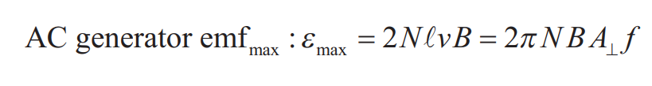
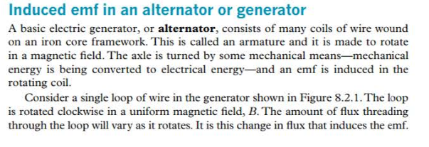
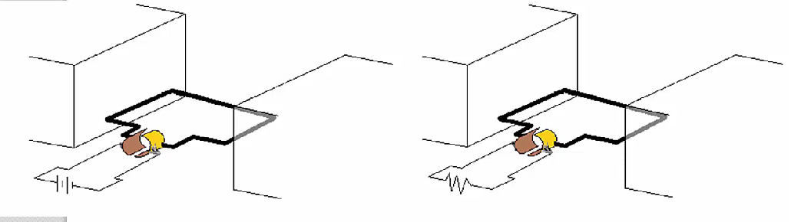
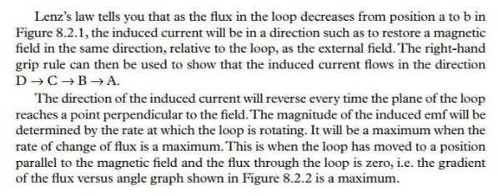
AC Generators
Content Development
Motor: flows a current through a coil inside a magnetic field to generate motion
electrical energy → kinetic energy
Generator: moves a coil inside a magnetic field to generate electricity
kinetic energy → electrical energy
Motor
Generator

Slide 6
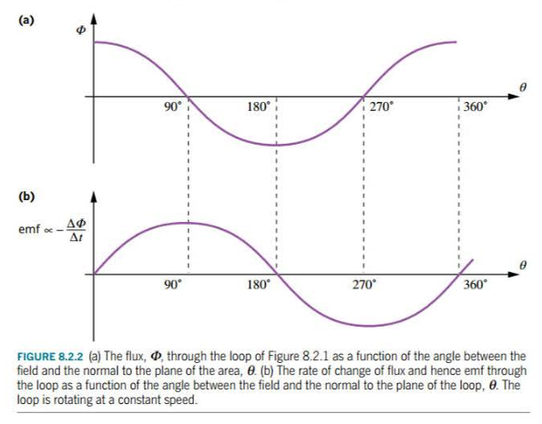
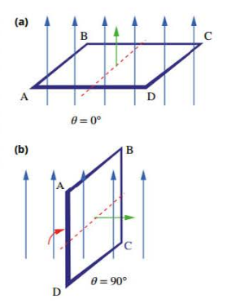
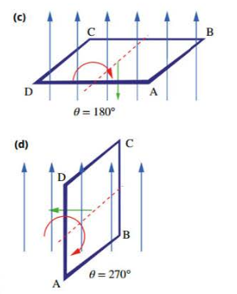
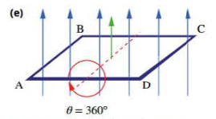
AC Generators
Content Development
Notes:
Current flows D → C → B → A
Current reverses every time the plane is perpendicular to the field (0, 180, 360)
Emf is a maximum when the rate of change of flux is a maximum. This is when the coil is parallel to the field (90 and 270 degrees in picture) (goes from no flux to flux)

Slide 7
AC Generators
Content Development
Where f = the frequency (Hz) = 1 / period

Slide 8
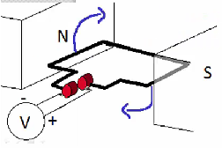
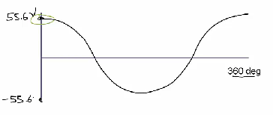
AC Generators
Content Development
A generator is made up of 80 turns of a coil and is rotating at 96.0 rpm within a 8.00 T field. The coil is 7.20 cm wide and 12.0 cm long.
Calculate the max emf produced
Plot the emf (as measured by the voltmeter for one complete turn.
Notes:
f = RPM/60 = 1.6 Hz
Emf max = 55.6 V
If the current is flowing into the positive end of the voltmeter, positive emf
Starting:
Field is parallel with the coil. Lowest flux going through coil. Largest change in flux. Largest emf.
So starting at maximum emf.
Direction:
Use right hand velocity palm rule for segment of coil (the one closest to N). Thumb points towards velocity. Fingers point towards field lines. Palm is the force on the positive charges → up (clockwise, towards the positive end of the voltmeter). Therefore starting with a positive voltage.
At 90 deg:
Field is perpendicular to coil. Largest flux going through. Lowest change in flux. Lowest emf.
So minimum at 90deg.

Slide 9

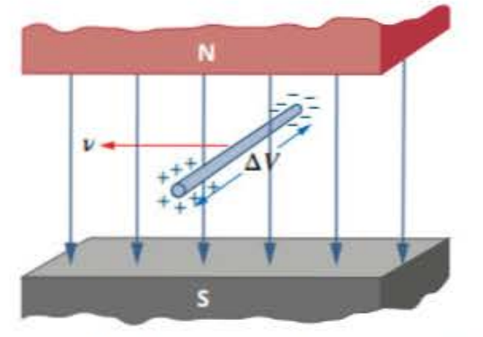
emf due to moving conductor
Content Development
Remember: emf is a voltage
ε = V = IR = L v B
With the setup to the left, calculate the resistance in the resistor when:
Current is 2A
Velocity is 2 m/s
The length of wire inside the magnetic field is 0.8 m
Magnetic field strength is 4 T.
Notes:
Emf = V = IR = L v B
R = LvB / I = 0.8 * 2 * 4 / 2 = 3.2 ohms

Slide 10
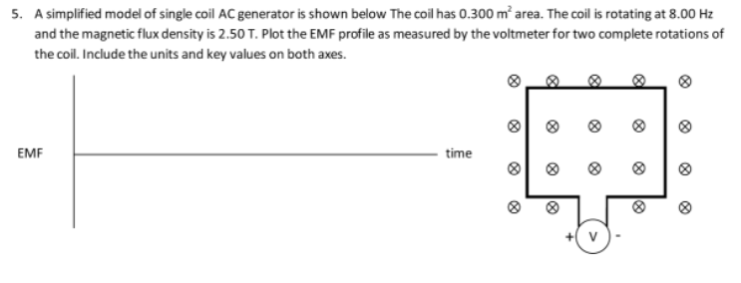
AC Generators
Content Development

Slide 11
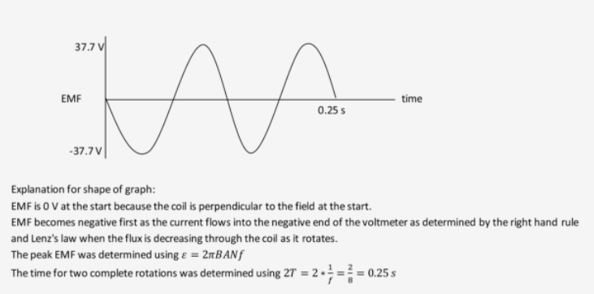
AC Generators
Content Development

